Slide 1

Behaviour Analytics in neurosurgery
Abdullah Rehman
MEng Project
Brain & Behaviour Lab
Supervisor: Prof. Aldo Faisal
Co-supervisor: Dr. Amr Nimer

Slide 2

Introduction
Lecture 5%
Becoming a neurosurgeon requires arduous training.
This issue is aggravated by an overburdened healthcare system.
The traditional teaching method: The “See one, do one, teach one”.
Reading 10%
Audiovisual 20%
Demonstration 30%
Discussion 50%
Practice Doing 75%
Teach Others 90%

Slide 3
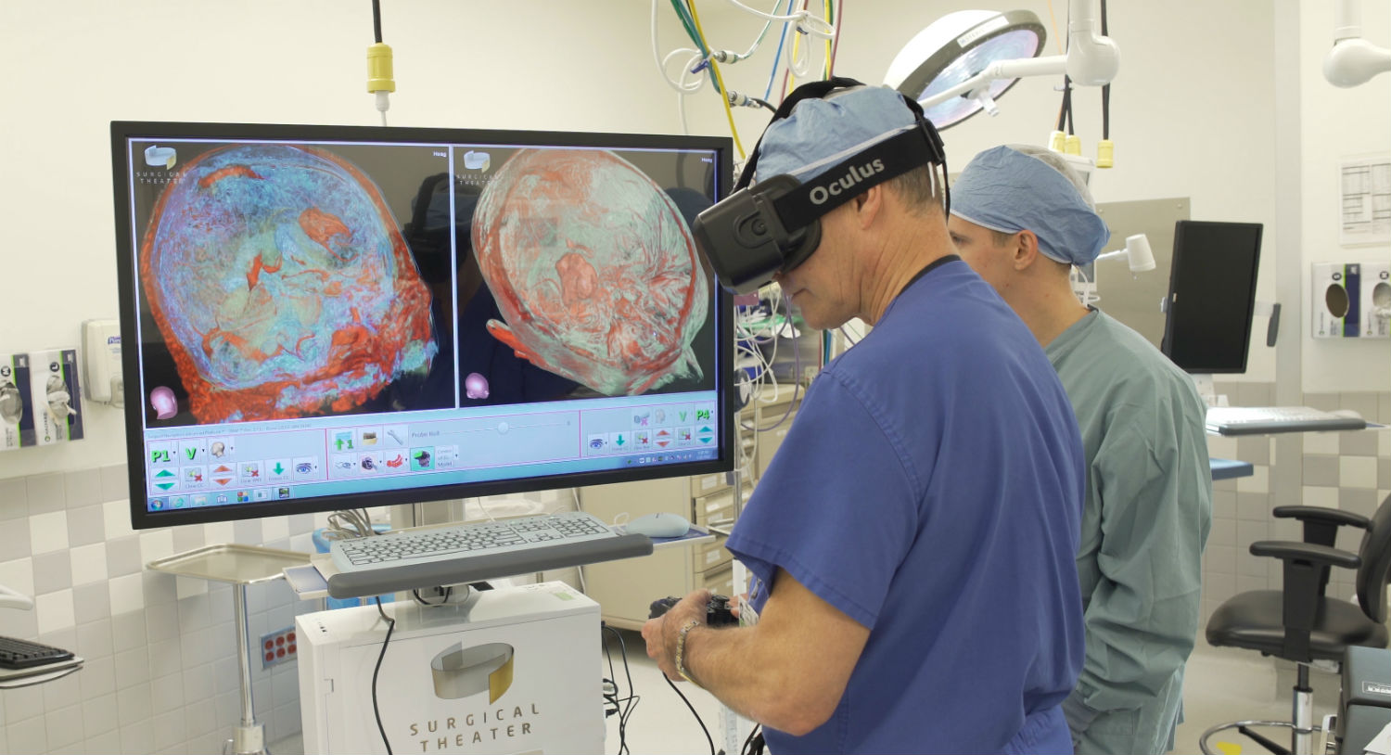
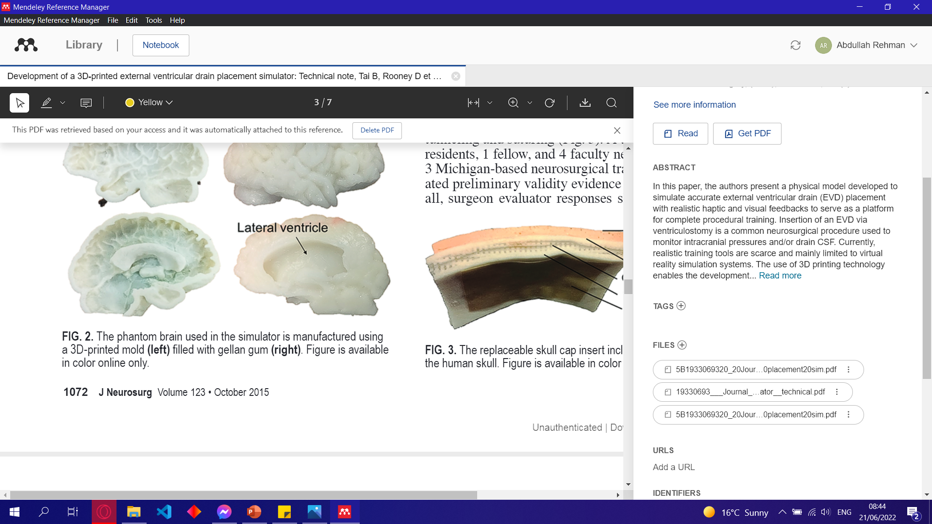
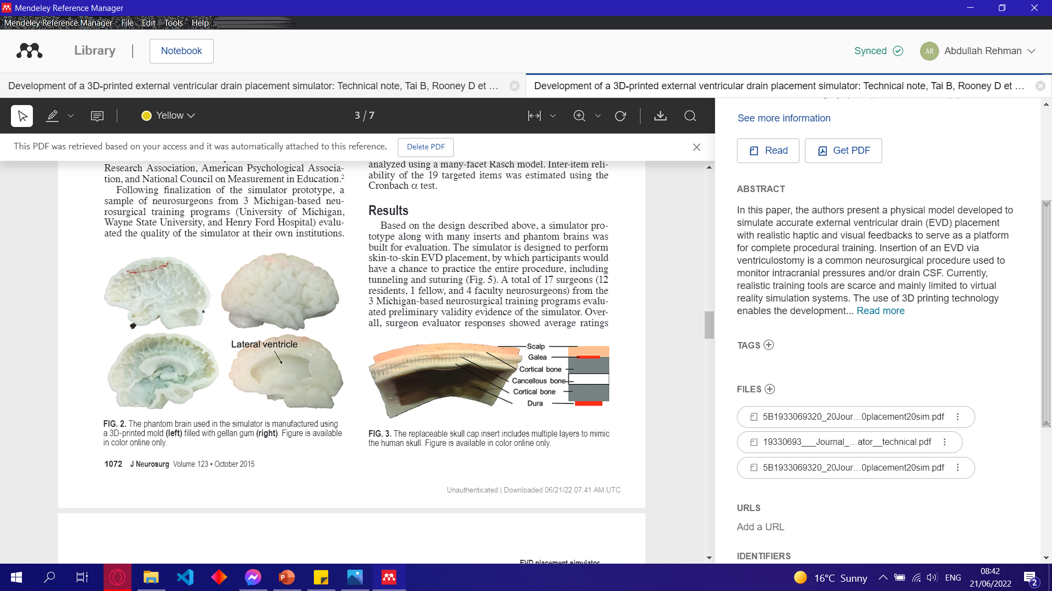
Background
Recent research explores Virtual Reality simulations and 3D printed models.
Lack of medical feedback systems.
Large gap in research for data driven and active feedback systems in neurosurgery.

Slide 4
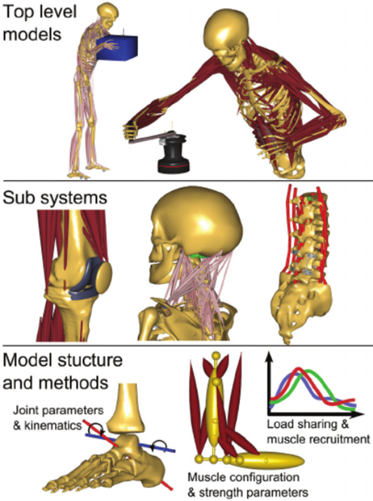
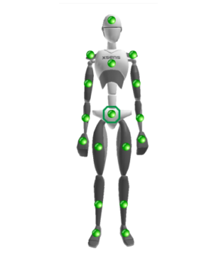
Background
Motion capture technology is used to capture kinematic data.
Machine learning algorithms were used to extract “synergies”.
Dictionary Learning algorithms were explored.
Large research gap remains for full body synergies undergoing fine movement.

Slide 5
Aims and Objectives
Develop a dedicated dictionary learning algorithm.
Extract synergies from expert and novice neurosurgeons.
Lay the foundations for a feedback system

Slide 6
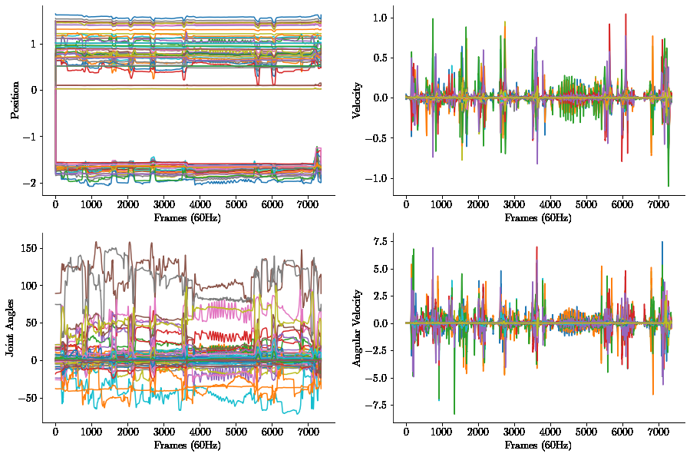
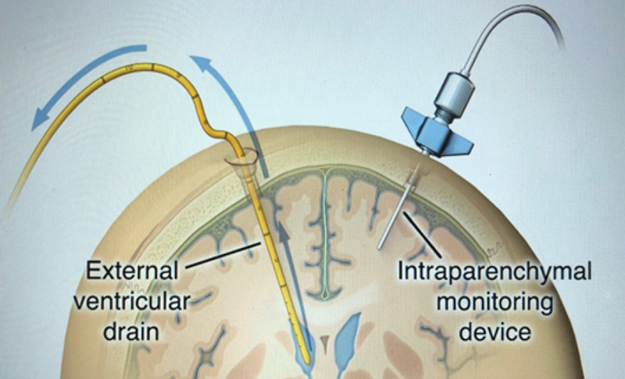
Neurosurgical Data
Data collected during the External Ventricular Drain procedure using the Xsens suit (IMUs).
22 different joints were recorded in the X, Y, and Z axis resulting in a 66 feature space.
Data was preprocessed by mean-centring.
Notes:
Put table after

Slide 7

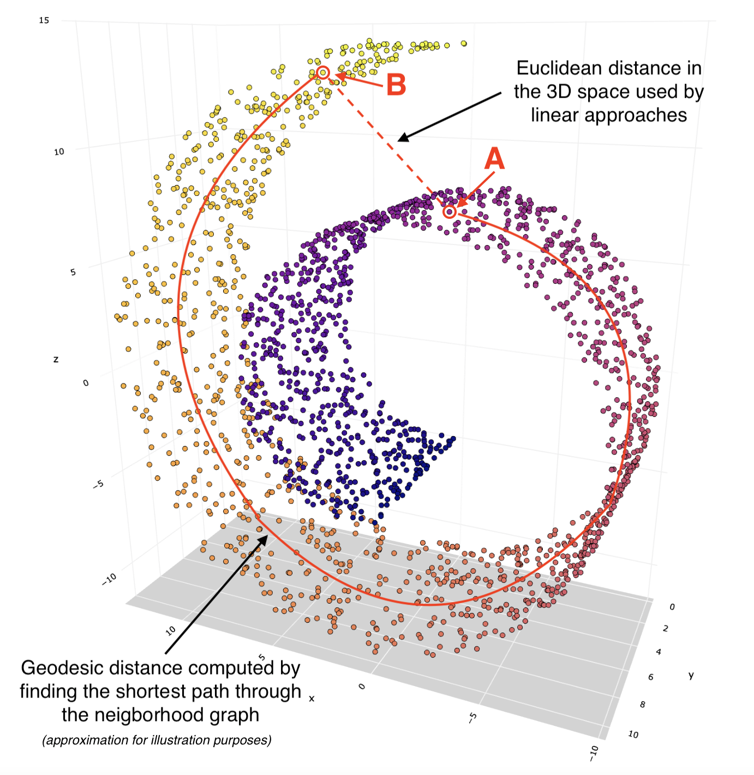
Dimensionality Reduction
Principle Component Analysis (PCA)
Isometric Mapping (ISOMAP)
Notes:
Put table after

Slide 8
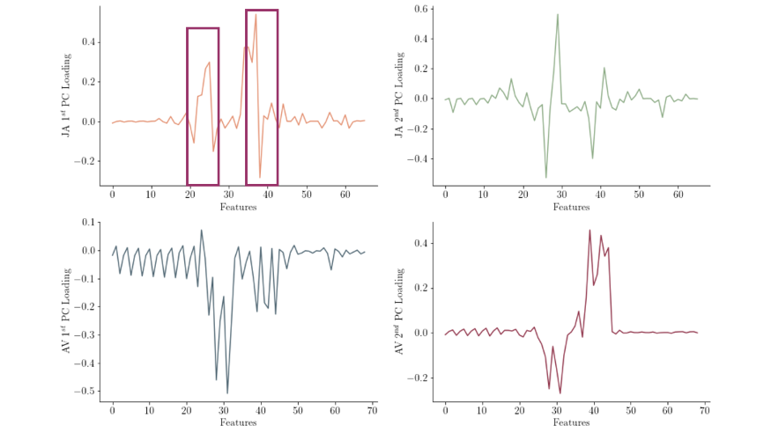
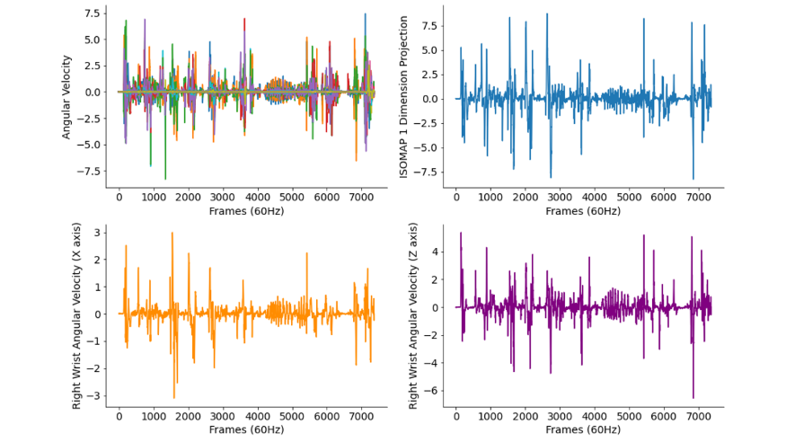
Dimensionality Reduction Results
Principle Components Extracted
1st Dimension of ISOMAP
Notes:
Put table after

Slide 9
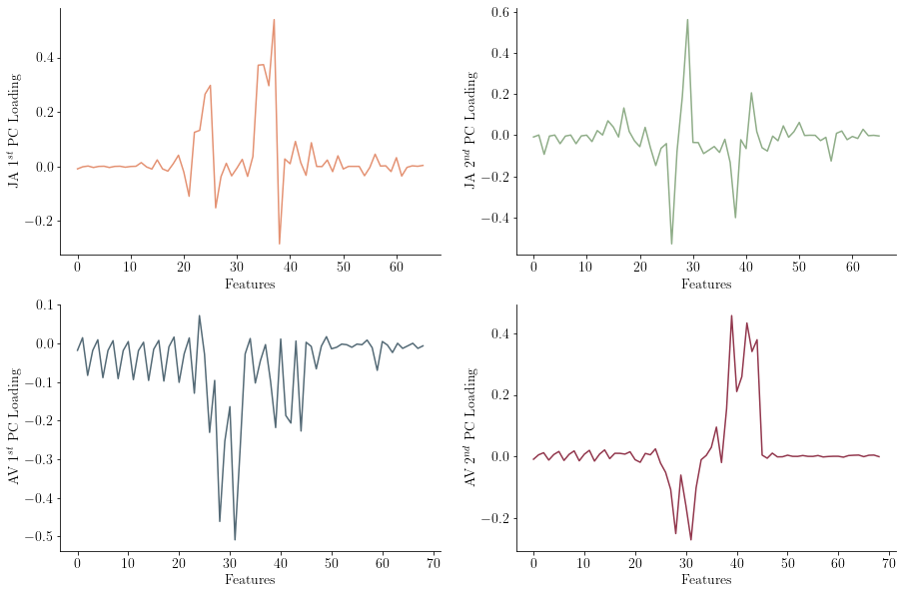

Slide 10
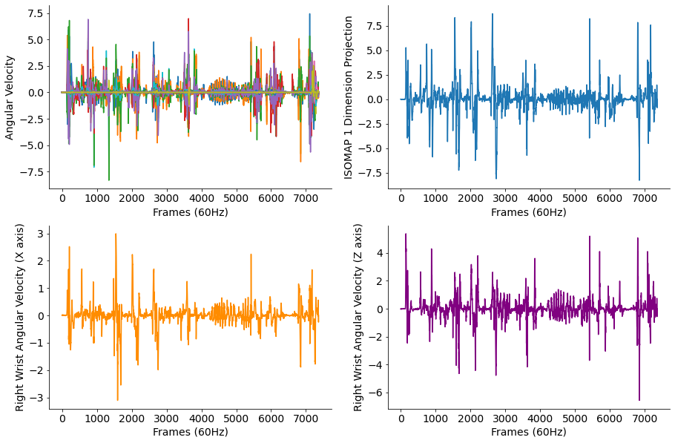

Slide 11
Dictionary Learning Algorithms
Sparse Eigenmotion Decomposition Algorithm (SEMD)
Extracts Eigenmotions: A highly generalisable PC extracted from a region of interest (ROI)
Developed for natural human movement data
Eigenaction Extraction Algorithm
Eigenactions: Groups of eigenmotions which synergise well
Developed for robotic hand data
Notes:
Put table after

Slide 12
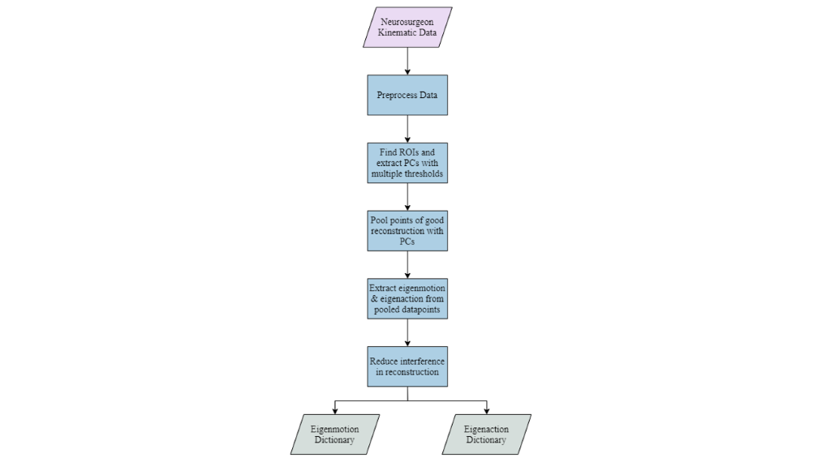
Enhanced SEMD (ESEMD)
The previous algorithms were modified and improved upon to make the ESEMD.
This is capable of extracting both eigenmotions and eigenactions for neurosurgical kinematic data.
An interference reduction stage was introduced.
Notes:
Put table after

Slide 13
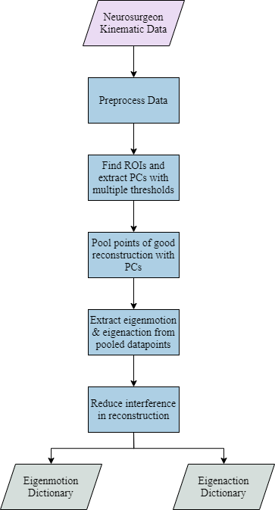

Slide 14
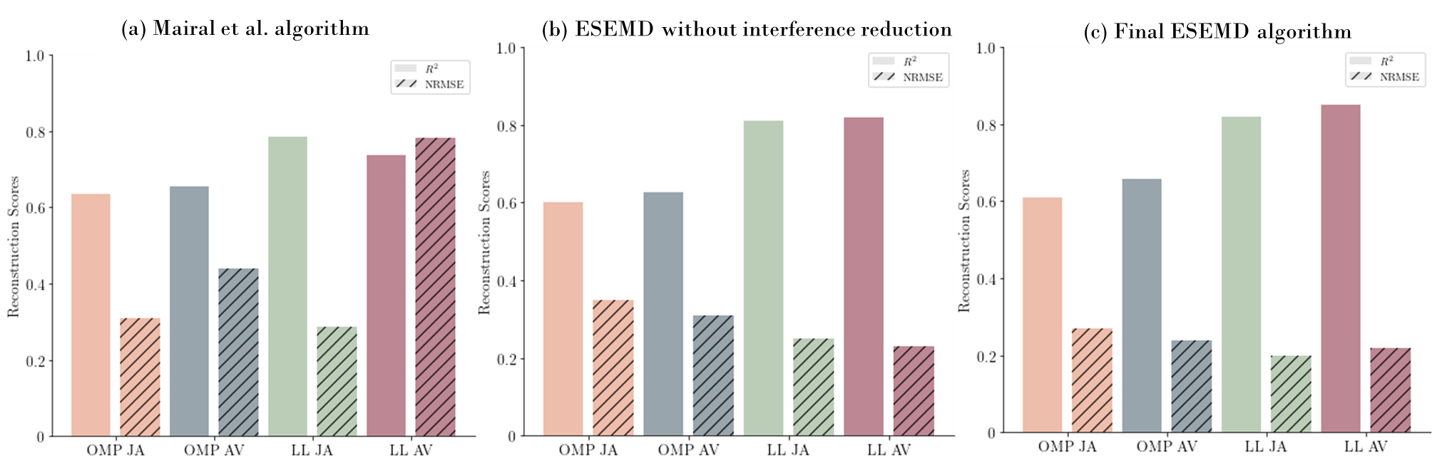
Eigenmotion Dictionary Results
The dictionaries extracted were reconstructed with:
Orthogonal Matching Pursuit (OMP)
Least Absolute Shrinkage And Selection – Least Angle Regression (LASSO-LARS).

Slide 15
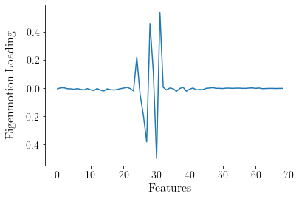
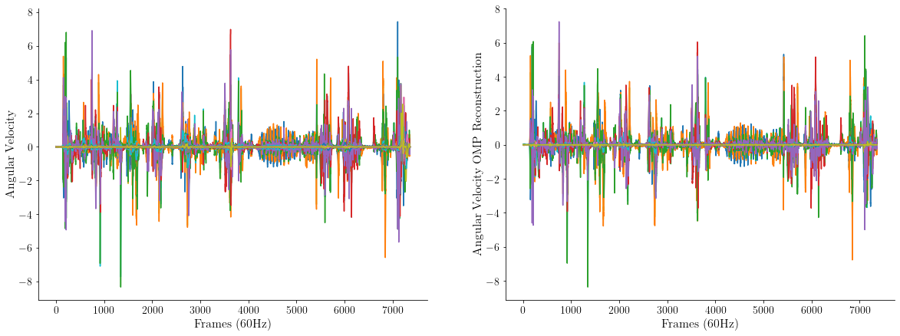

Eigenmotion Dictionary Results
Original Dataset
Reconstructed Dataset
Most Significant Eigenmotion
Final $R^{2}$: 0.657
Final NRMSE: 0.239
Notes:
Put table after

Slide 16
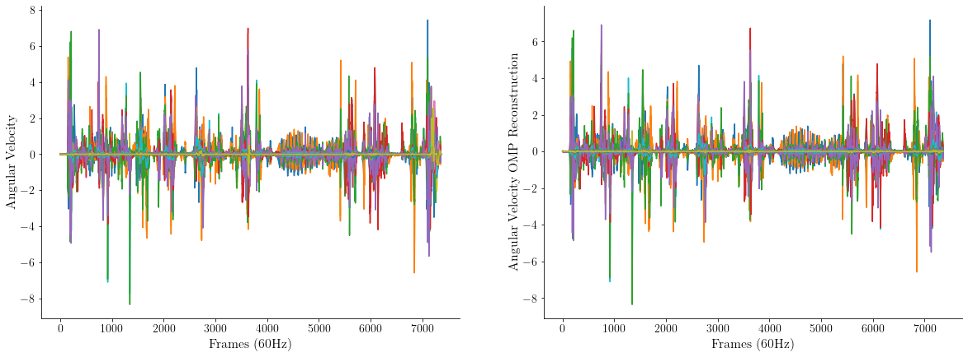
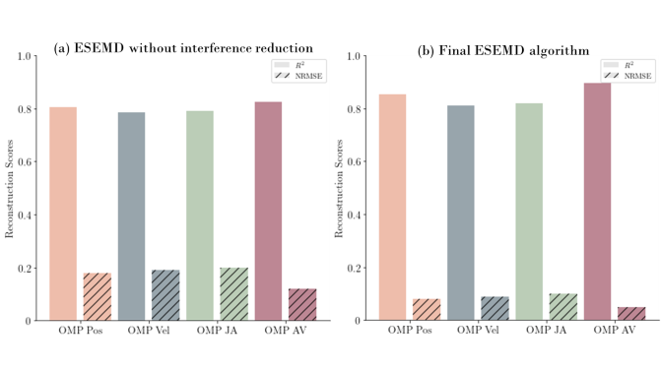
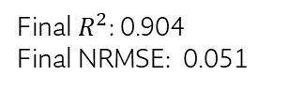
Eigenaction Dictionary Results
Original Dataset
Reconstructed Dataset
Final $R^{2}$: 0.904
Final NRMSE: 0.051
Notes:
Put table after

Slide 17
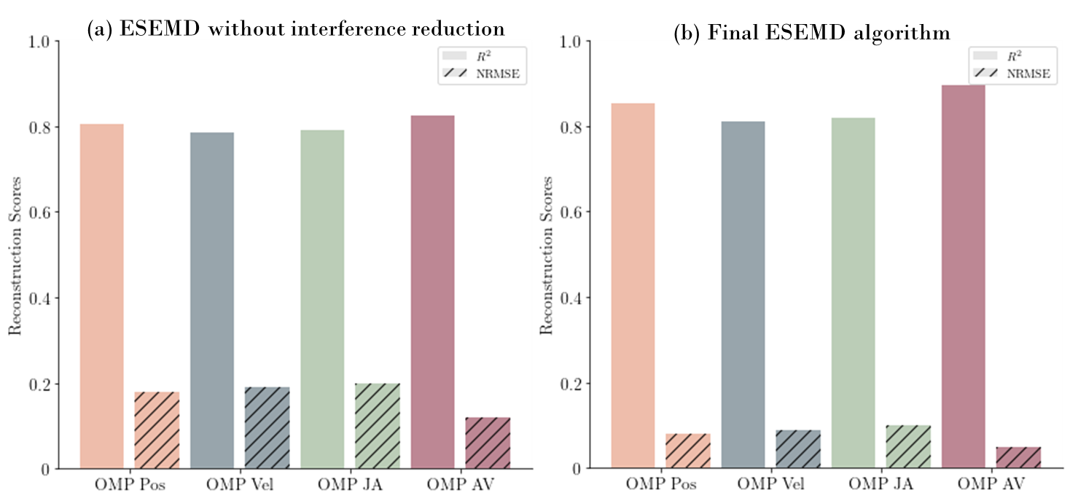

Slide 18
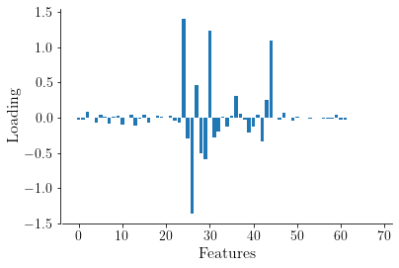
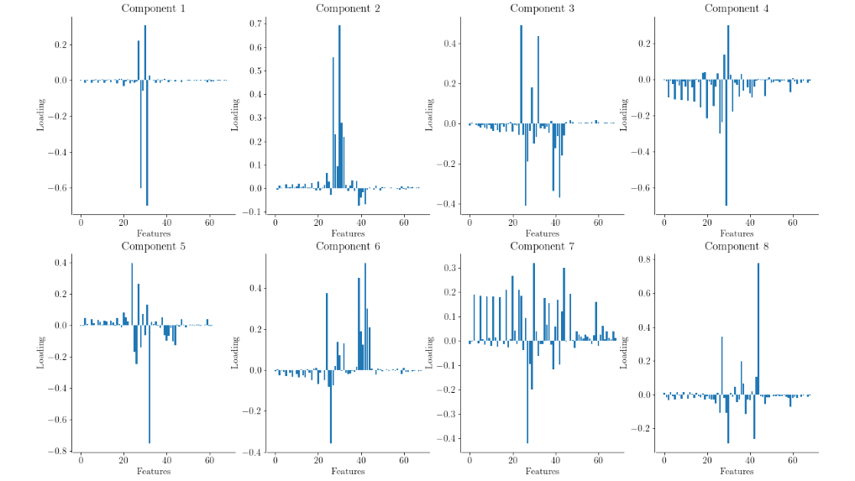
Most Significant Eigenaction Components
Notes:
Put table after

Slide 19
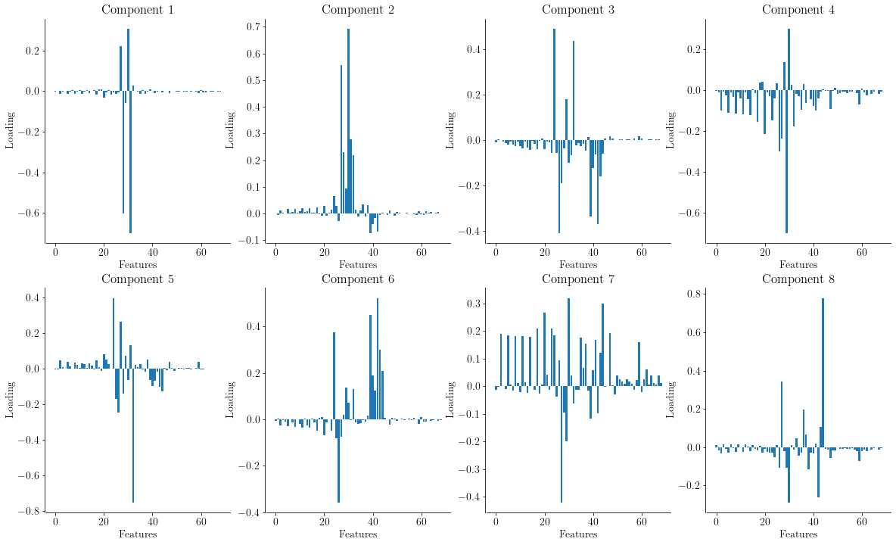

Slide 20
Novice Neurosurgeon Analysis
Dictionaries were extracted from novice kinematic data.
A real-time error visualiser was implemented for their movements.
Notes:
Put table after

Slide 21
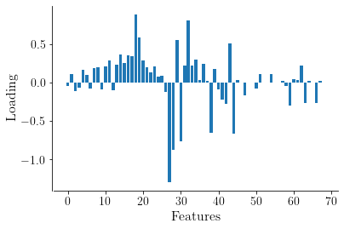
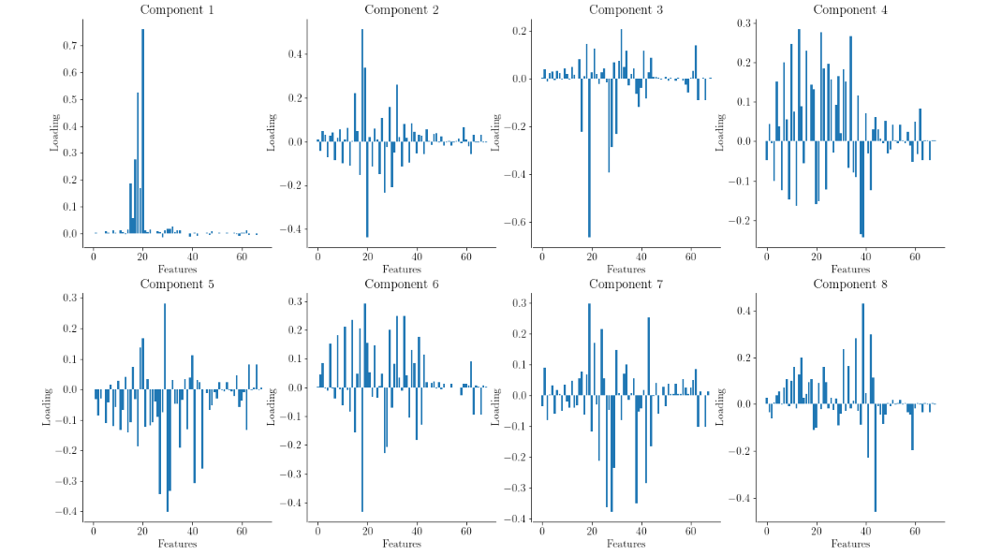
Most Significant Novice Eigenaction
Notes:
Put table after

Slide 22
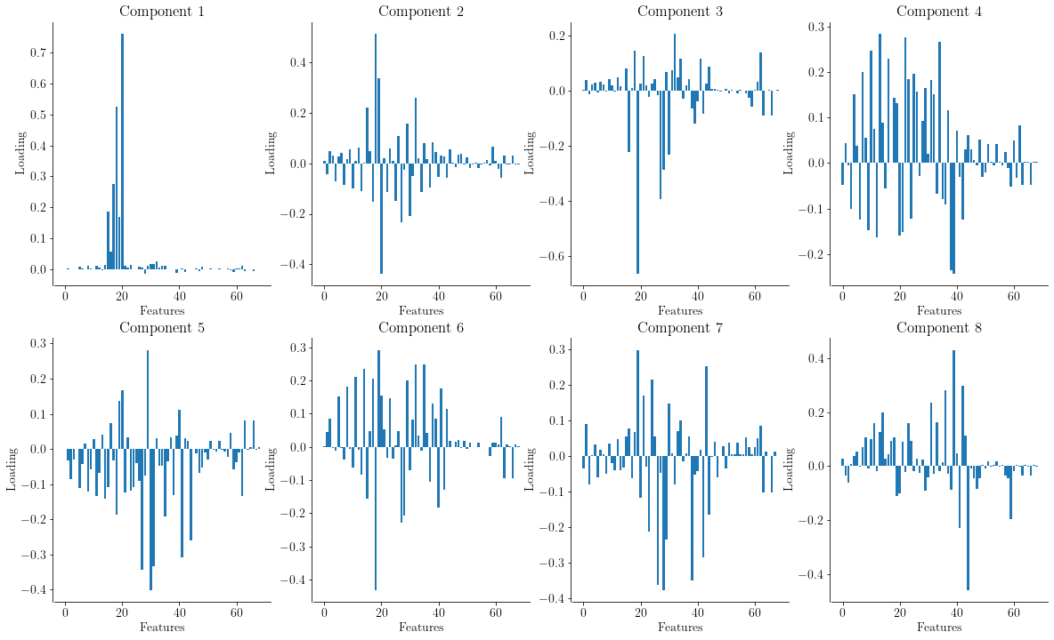

Slide 23
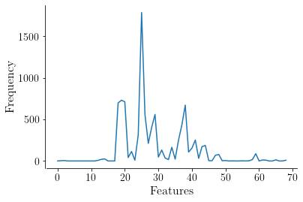
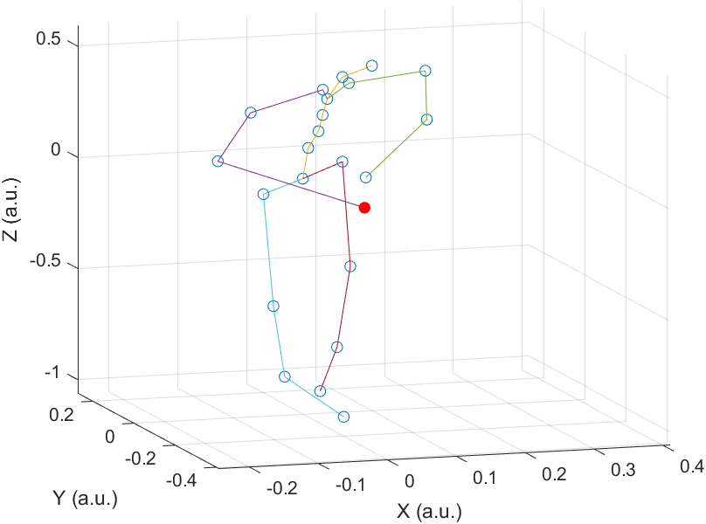
Novice Neurosurgeon Error Visualiser
Features with highest error
Novice error visualiser
Notes:
Put table after

Slide 24
Discussion
ESEMD successfully extracts dictionaries.
Sets of eigenactions naturally correspond to surgical tasks.
Variance and error are localised in the arm joints.
The need for refinement in the novice’s movements.
Notes:
ESEMD demonstrably outperforming all other dictionary learning algorithms, especially in the context of surgical kinematics where it is pioneering new ground
Summary of key results, localisation of variance and error for novices in the right upper limb joints in ESEMD, PCA and ISOMAP, how this verifies the accuracy of the ESEMD as this is where the most variance is expected
how certain synergies correspond to certain actions such as in drilling
The lack of focus and need for refinement in novice neurosurgeons movements visually explained, the differences in their movements

Slide 25
Conclusion
The ESEMD is a pioneering step in surgical kinematic data analysis.
Further research is still required in expert and novice neurosurgeons.
Promising steps made towards implementing a feedback and training system.
Notes:
Further research in the upper limbs, in the movements of novices, and in the relevance of the feedback system
Promising steps made towards implementing a complete feedback and training system and revolutionising neurosurgical skill acquisition
Percentage of improvement from mairal

Slide 26
Thank you!

Slide 27
Any Questions?

Slide 28
References
M. Taylor, Why is there a shortage of doctors in the uk?, The Bulletin of the Royal College of Surgeons of England, 102 (2020), pp. 78–81.
S. V. Kotsis and K. C. Chung, Application of the ”see one, do one, teach one” concept in surgical training, Plastic and Reconstructive Surgery, 131 (2013), pp. 1194–1201.
A. Alaraj, M. Lemole, J. Finkle, R. Yudkowsky, A. Wallace, C. Luciano, P. Banerjee, S. Rizzi, and F. Charbel, Virtual reality training in neurosurgery: Review of current status and future applications, Surgical Neurology International, 2 (2011), p. 52.
B. L. Tai, D. Rooney, F. Stephenson, P. S. Liao, O. Sagher, A. J. Shih, and L. E. Savastano, Development of a 3D-printed external ventricular drain placement simulator: Technical note, Journal of Neurosurgery, 123 (2015), pp. 1070–1076.
O. Portillo-Rodriguez, O. O. Sandoval-Gonzalez, E. Ruffaldi, R. Leonardi, C. A. Avizzano, and M. Bergamasco, Real-Time Gesture Recognition, Evaluation and Feed-Forward Correction of a Multimodal Tai-Chi Platform, 2008.
J. N. Ingram, K. P. Kording, I. S. Howard, and D. M. Wolpert, The statistics of natural hand movements, Experimental Brain Research, 188 (2008), pp. 223–236.
A. A. C. Thomik, On the Structure of Natural Human Movement, PhD Dissertation: Dept. of Bioengineering, Imperial College London, 2015.
E. Todorov and G. Z, Analysis of the synergies underlying complex hand manipulation, (2004).
I. Issak, Learning to Control the Ethohand with Eigenactions for Action Discretization, 2021.
J. Mairal, F. B. FRANCISBACH, J. Ponce, E. N. Sup´erieure, and G. Sapiro, Online Dictionary Learning for Sparse Coding, 2009.
J. B. Tenenbaum, V. de Silva, and J. C. Langford, A Global Geometric Framework for Nonlinear Dimensionality Reduction, Science, 290 (2000), pp. 2319–2323.
G. T. Meijer, P. Marchesi, J. F. Mejias, J. S. Montijn, C. S. Lansink, and C. M. Pennartz, Neural Correlates of Multisensory Detection Behavior: Comparison of Primary and Higher-Order Visual Cortex, Cell Reports, 31 (2020), p. 107636.

Slide 29
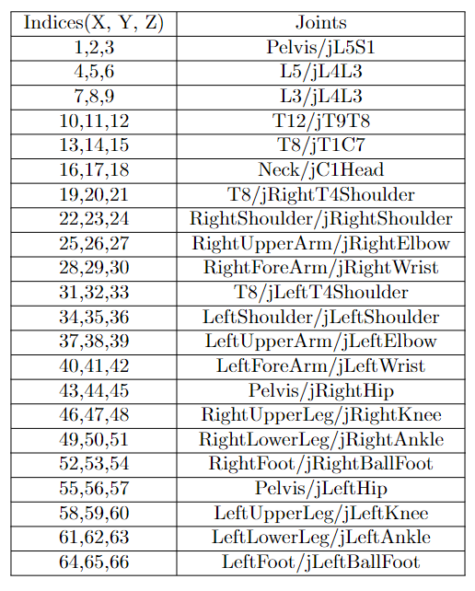
Indices of Joints
Notes:
Put table after

Slide 30
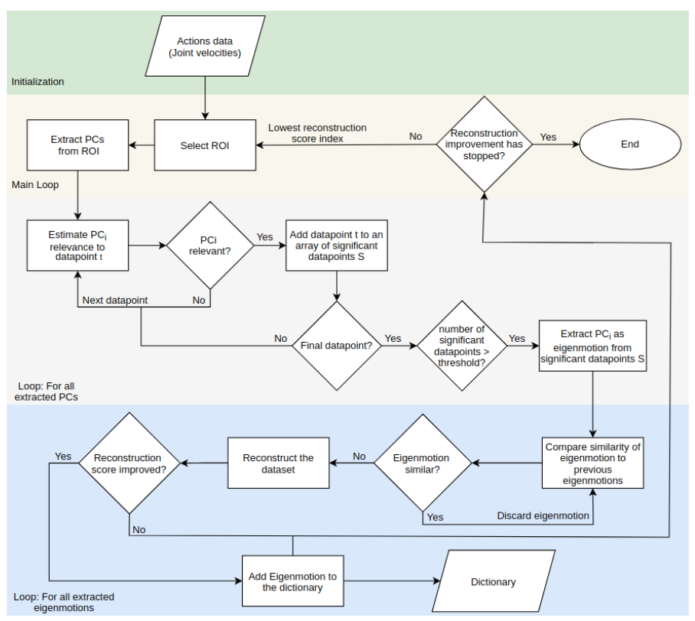

Slide 31
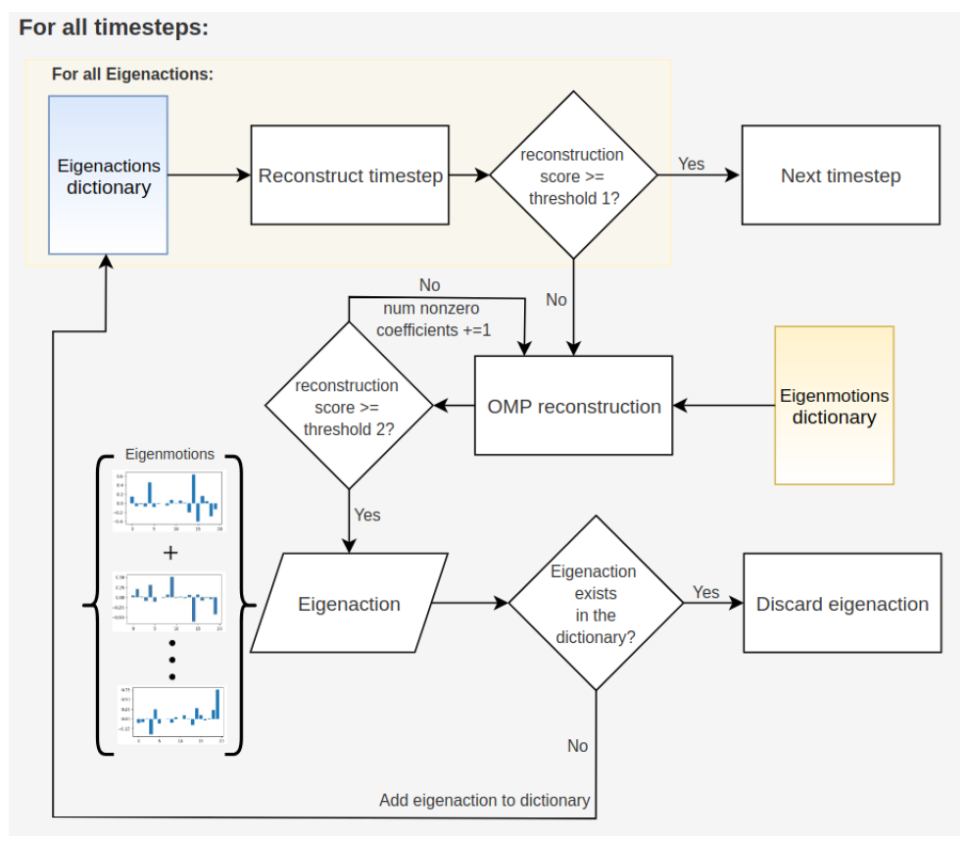

Slide 32
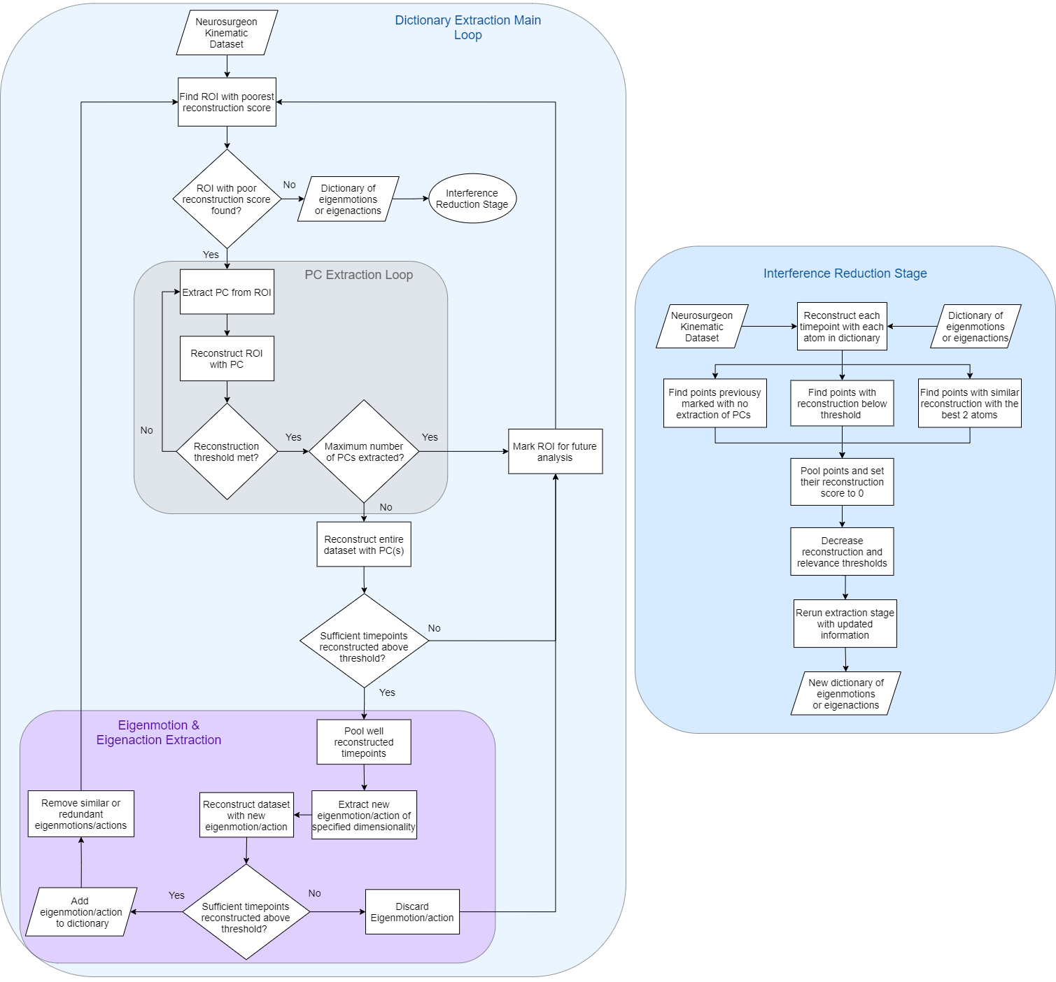

Slide 33
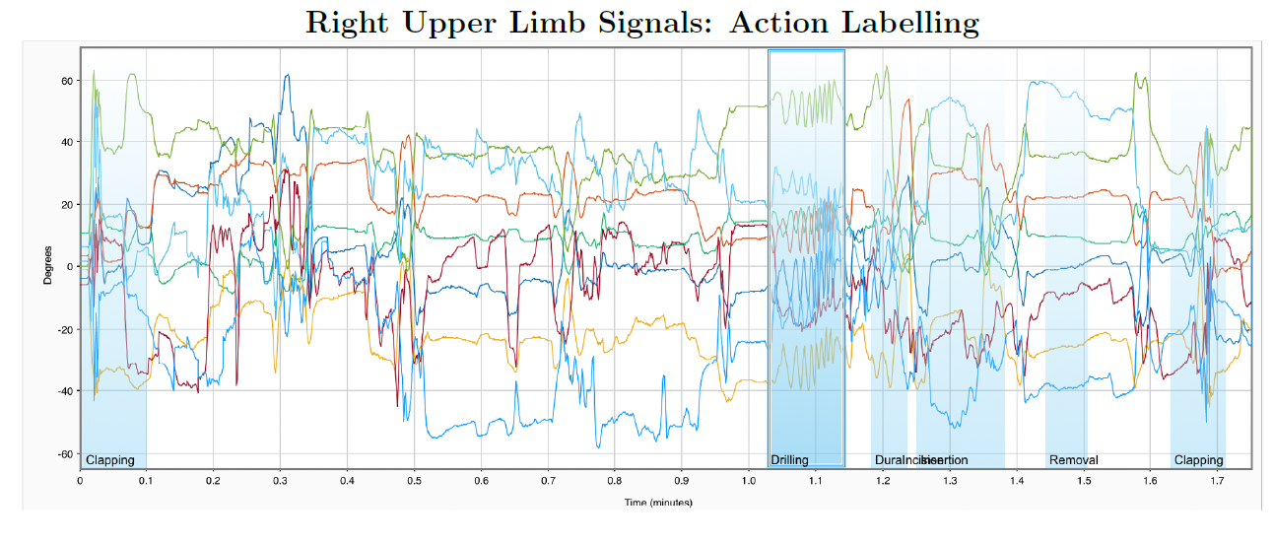
Surgical Eigenactions
Eigenactions used in reconstruction during specific surgical tasks were analysed.
Notes:
Put table after

Slide 34
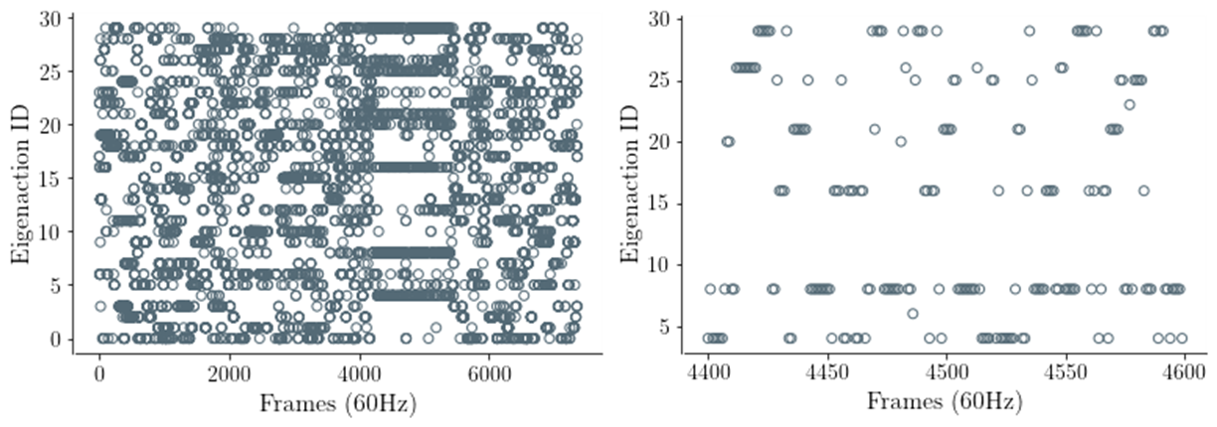
Surgical Eigenaction Results
Notes:
Put table after

